Slide 1
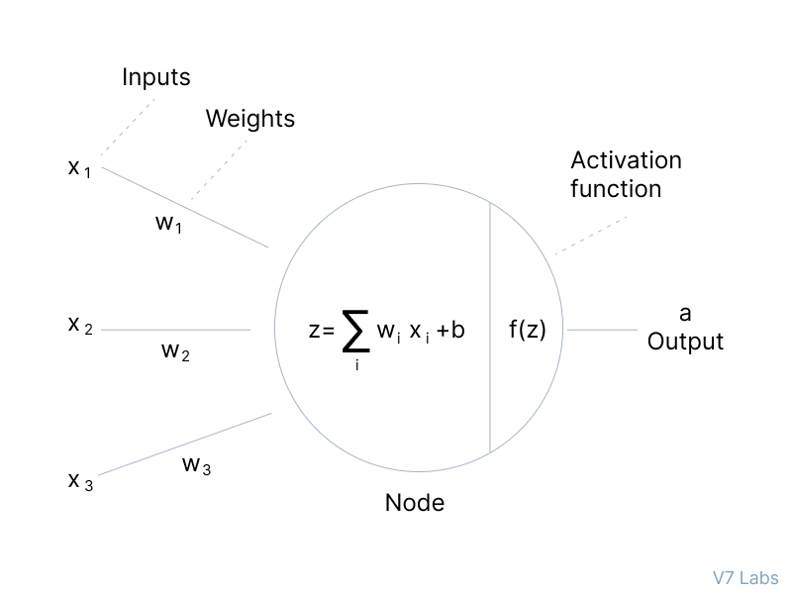
An Activation Function decides whether a neuron should be activated or not. This means that it will decide whether the neuron's input to the network is important or not in the process of prediction using simpler mathematical operations
Activation Function

Slide 2
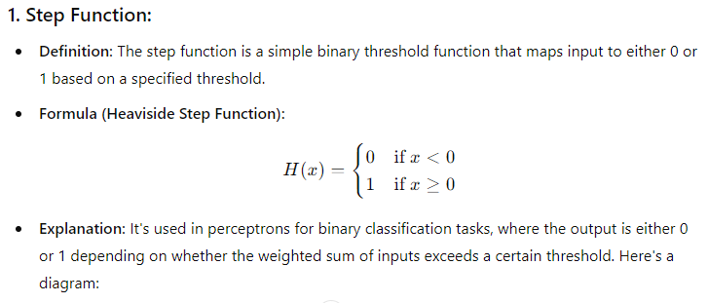

Slide 3
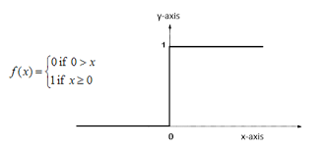
Step Function

Slide 4
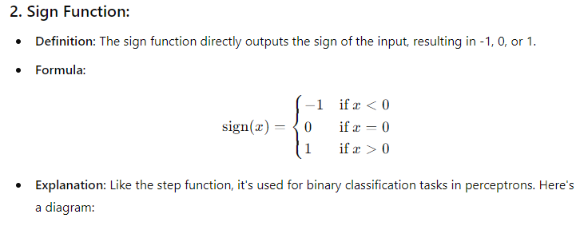

Slide 5
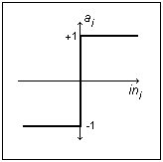
Sign Function

Slide 6

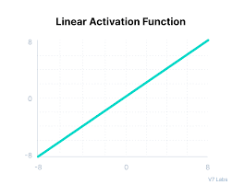

Slide 7

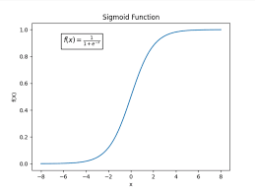

Slide 8

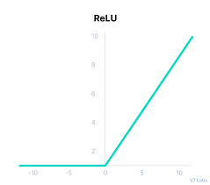

Slide 9

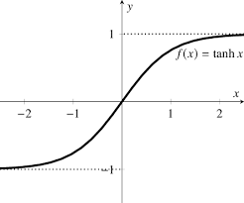

Slide 10

